Slide 1
Apache Kafka
Enabling high-volume, galactic scale, event-driven systems
“A distributed system is one in which the failure of a computer you didn't even know existed can render your own computer unusable”, Leslie Lamport

Slide 2
Overview
Intro
Architecture styles
Capabilities
How does it work?
Demo
APIs
Use Cases and Tools
Hosting
Conclusion

Slide 3
Architectural styles
Orchestration vs. Choreograpy
Sync vs. async

Slide 4
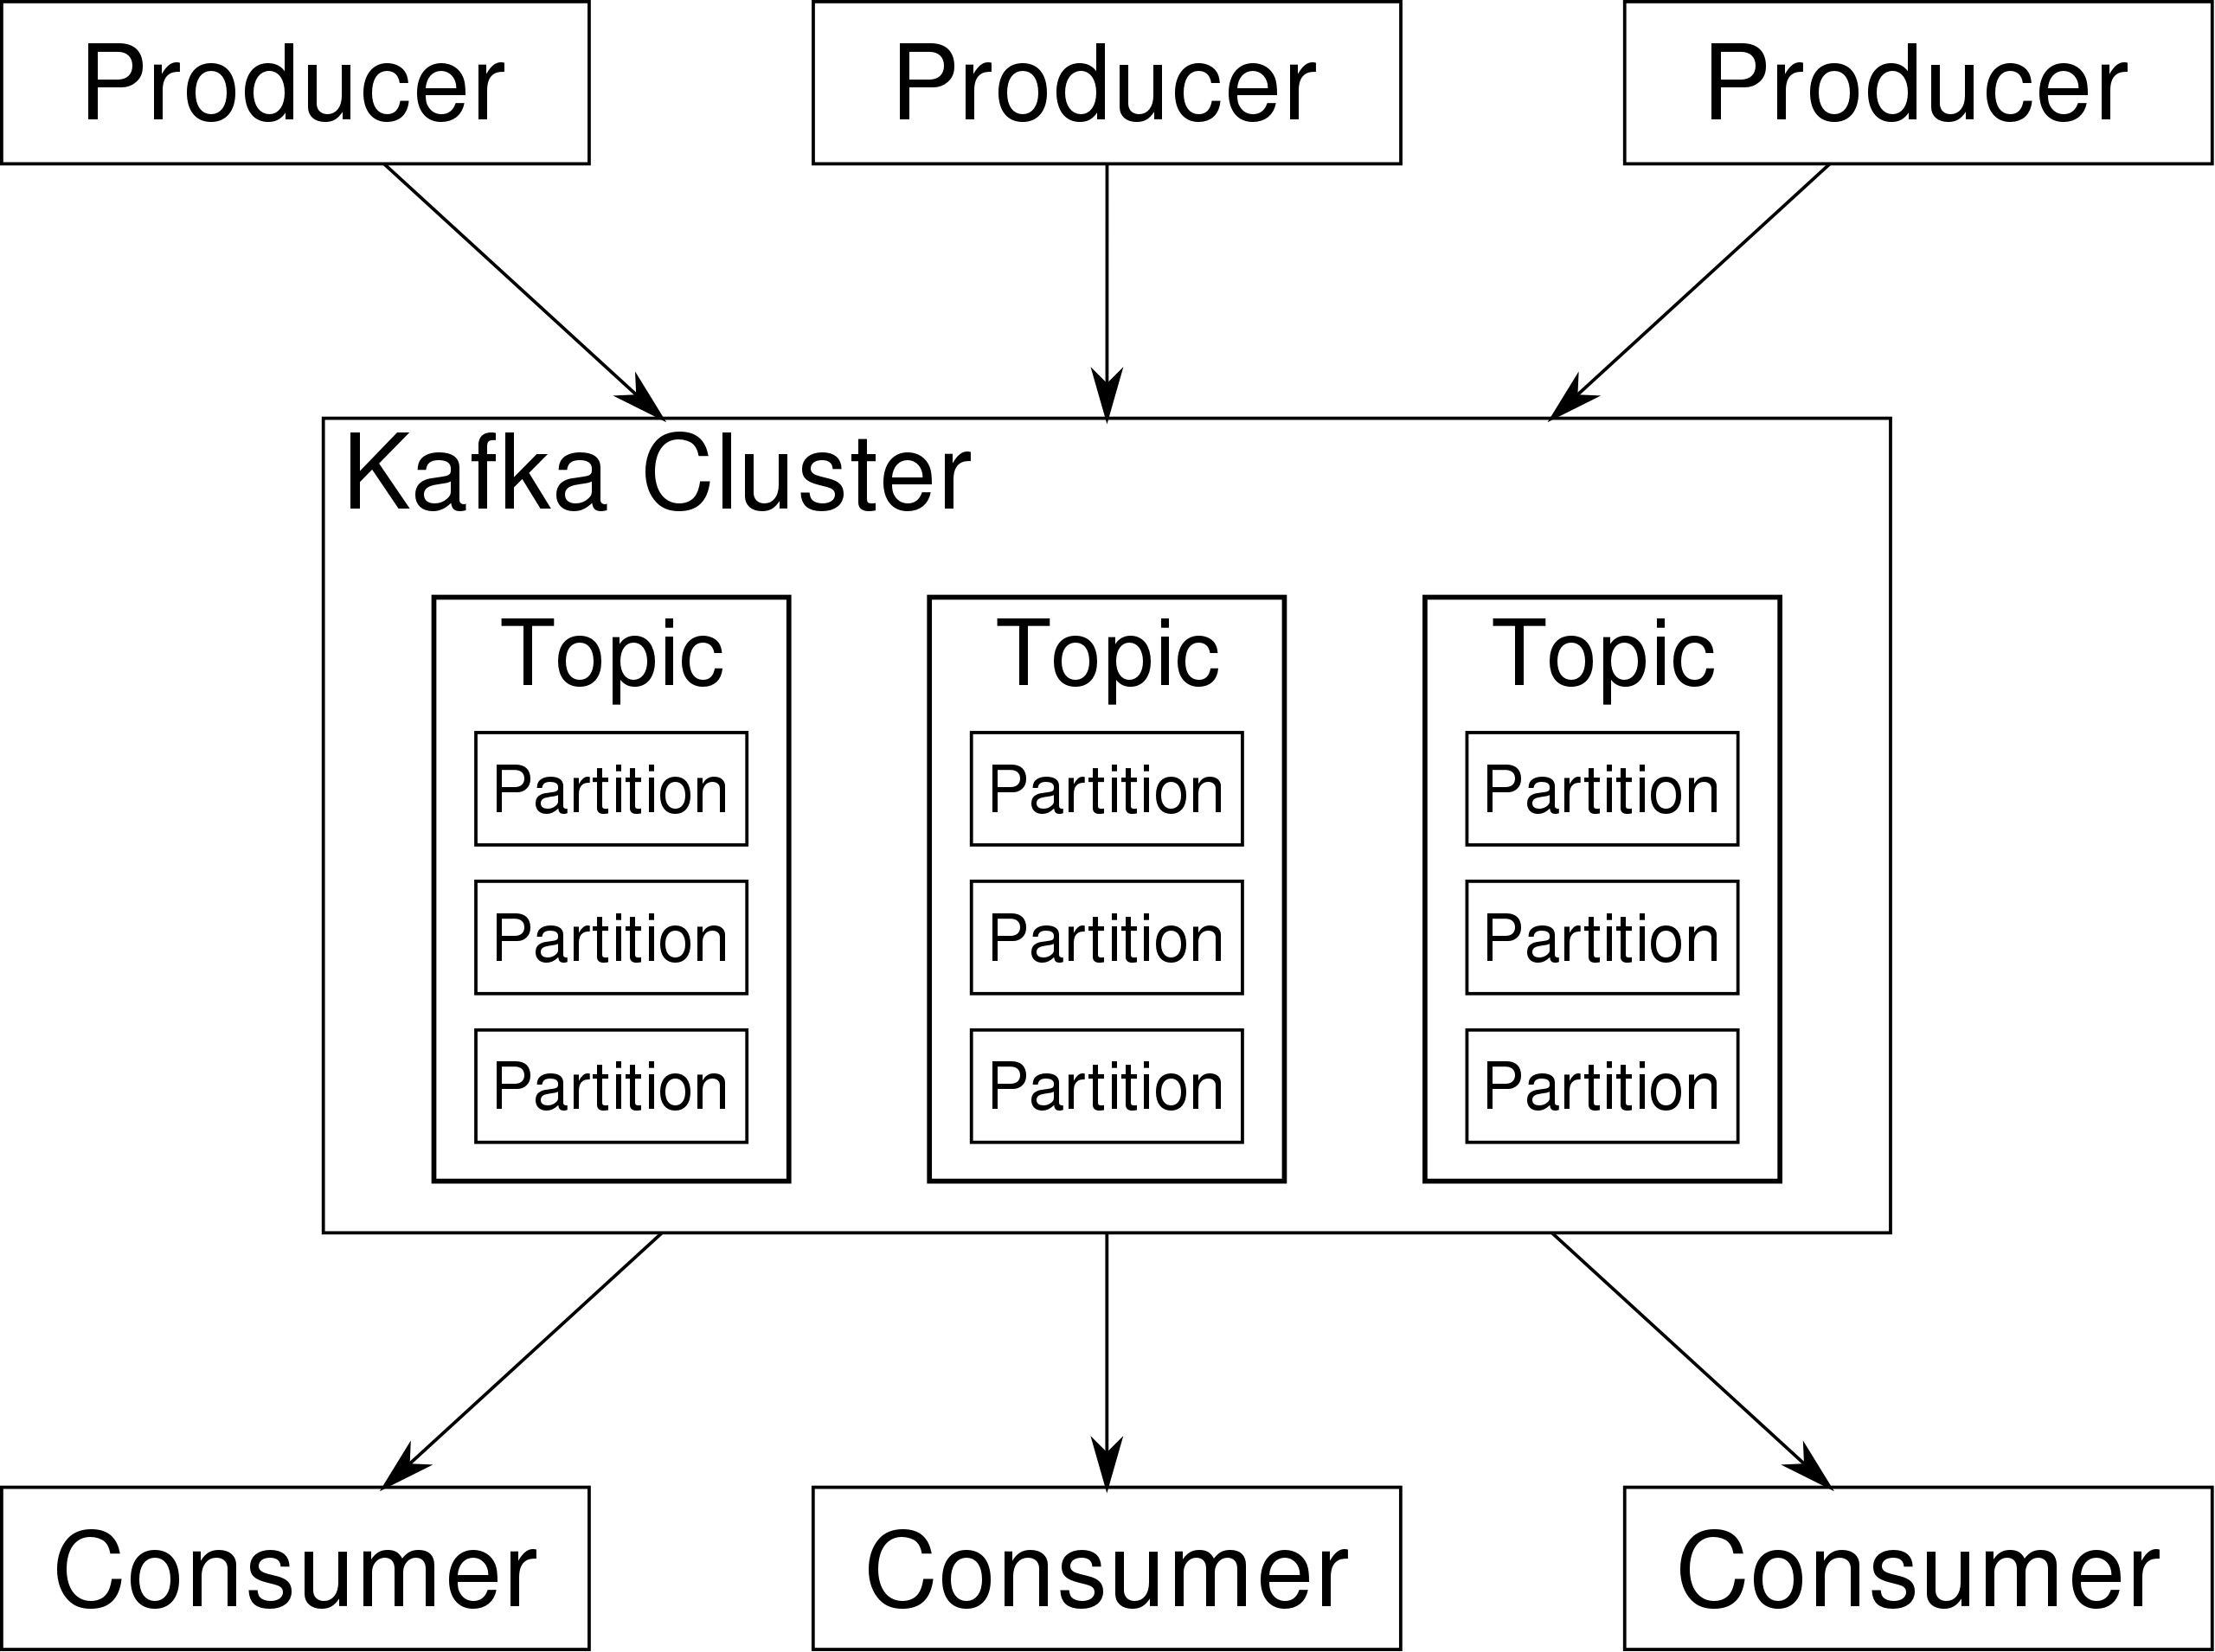
Kafka – the basics

Slide 5
Key capabilities
Pub/sub
Durability
Real-time and retrospective processing of events

Slide 6
How does it work?
Servers
Broker - persistence
Schema-registry – versioning of event contracts
Kafka Connect
Zookeeper
Clients
TCP

Slide 7
Concepts
Events
Key
Value
Timestamp
Topics
Offsets
Partitions
Consumer Groups
Producers
Consumers

Slide 8
Demo
A story of Pinger and Ponger
Demonstrates: producers, consumers, topics, consumer groups, kafkaUI
https://github.com/hloken/fagkveld-kafka

Slide 9
APIs
Admin API
Producer API
Consumer API
Kafka Streams API
Kafka Connect API

Slide 10
High-Level Features
Durability - persistent
Replication - Geo-scaling
Scalability – partitioning, clusters
Recoverability – immutable and replayable

Slide 11
Use cases
Messaging
Event Sourcing
Website Activity Tracking
Metrics
Log Aggregation
Stream Processing
Commit Log

Slide 12
UI Tools
KafkaUI - https://github.com/provectus/kafka-ui
Conduktor (paid)
+ many more! - https://www.reddit.com/r/apachekafka/comments/x9sov2/a_list_of_gui_tools_for_working_with_apache_kafka/

Slide 13
Managed Kafka
Confluent Cloud
RedHat OpenShift Streams
Heroku
AWS MSK Serverless
Upstash
Aiven

Slide 14
Conclusion
Kafka has a wide variety of use-cases and if you require massive scaling it’s kind of a no-brainer
Limits possible semanitcs in a message-based architecture (ex. no commands)
Requries dicipline for good recoverability: once something is in a topic it is immutable, no takesis-backsis!
Big community
Mature
Many 3rd party tools
Many suppliers of managed IaaS services + serverless etc.
Many different frameworks and add-on technologies (but no NServiceBus/MassTransit 😟)

Slide 15
Links
Demo repo: https://github.com/hloken/fagkveld-kafka
Kafka UI: https://github.com/provectus/kafka-ui
UI tools: https://www.reddit.com/r/apachekafka/comments/x9sov2/a_list_of_gui_tools_for_working_with_apache_kafka/
Confluent Cloud: https://www.confluent.io/
.NET Kafka client: https://github.com/confluentinc/confluent-kafka-dotnet
Krimson: https://github.com/RagingKore/Krimson

Slide 16
Easter Egg – Kafka integration patterns

Slide 17
Easter Egg 2 – Local projected caches

